Slide 1

Preparation for Lab 1
Week 2
Semester 1, 2025
Dr. Farshid Keivanian

Slide 2
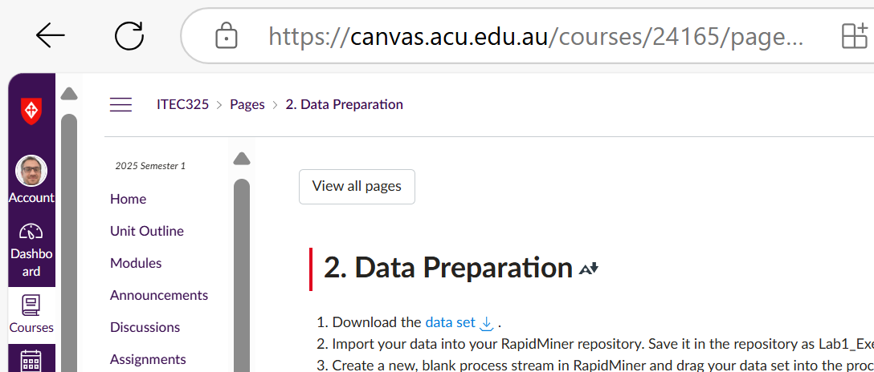
Data Preparation Using RapidMiner
Step 1: Download and Import the Data
Download the dataset and save it to your computer.
Import the dataset into RapidMiner and store it in your repository.
Rename the dataset in RapidMiner as Lab1_Exercise for easy reference.

Slide 3
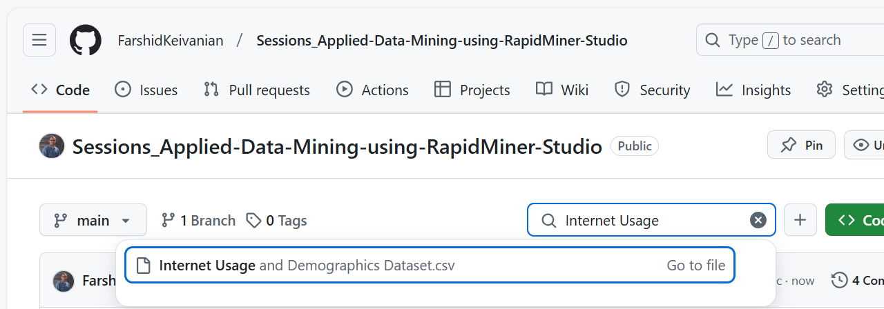
Data Preparation Using RapidMiner
“Internet Usage and Demographics Dataset", available on Github. It includes information about users' demographic details (gender, race, birth year, marital status) along with their internet habits (years on the internet, hours per day, preferred browser, search engine, email service, and social media usage).

Slide 4
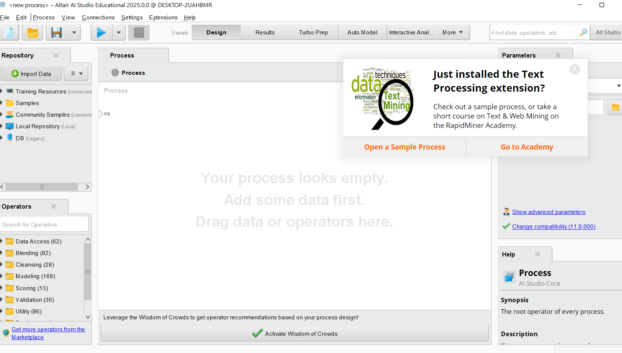
Data Preparation Using RapidMiner

Slide 5
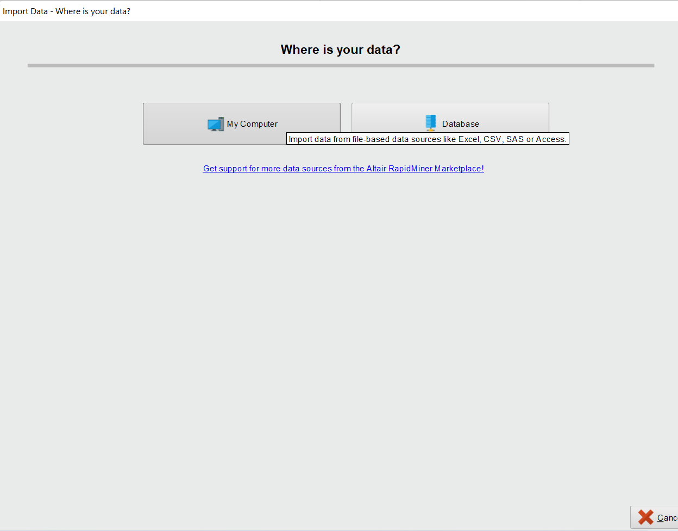
Data Preparation Using RapidMiner

Slide 6
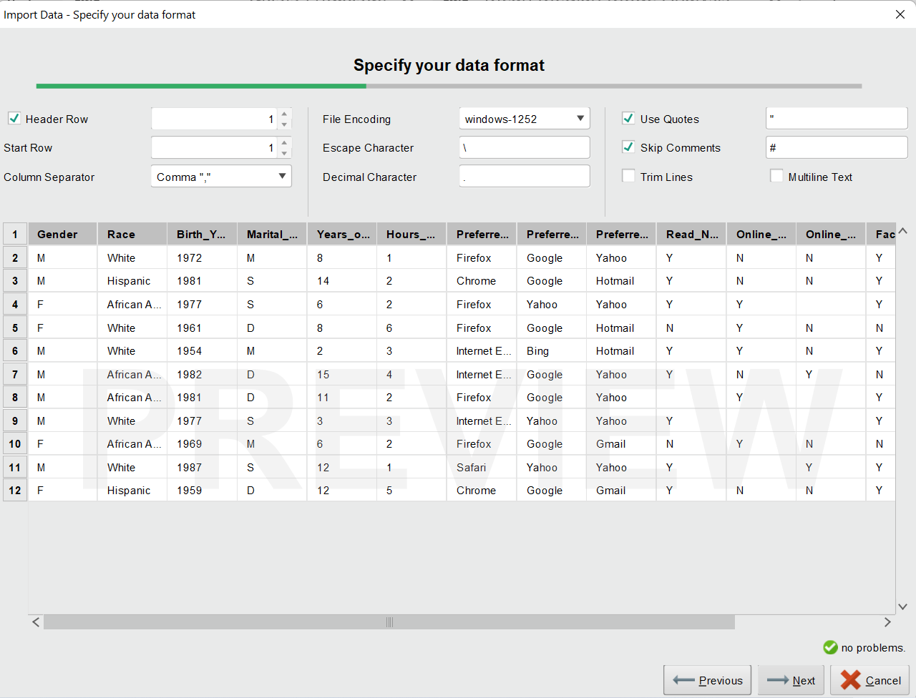
Data Preparation Using RapidMiner

Slide 7
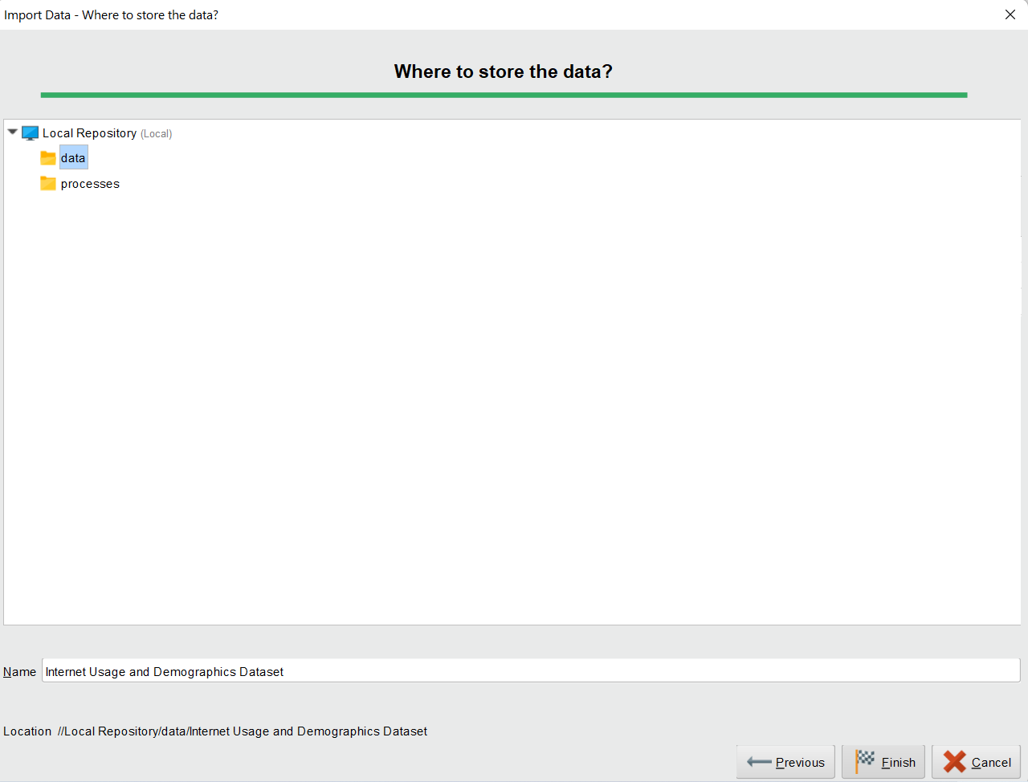
Data Preparation Using RapidMiner

Slide 8
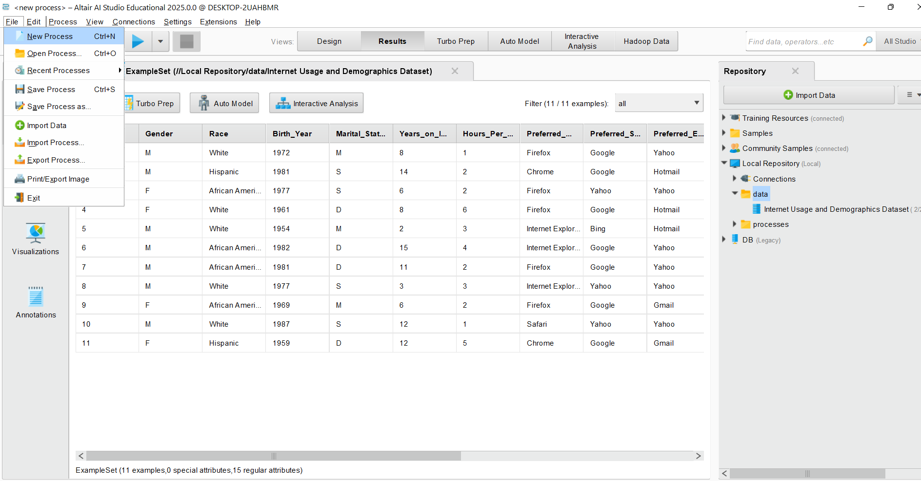
Data Preparation Using RapidMiner
Step 2: Set Up a New Process
1. Create a New Process
Open RapidMiner Studio.
Click File → New Process to create a new process.

Slide 9
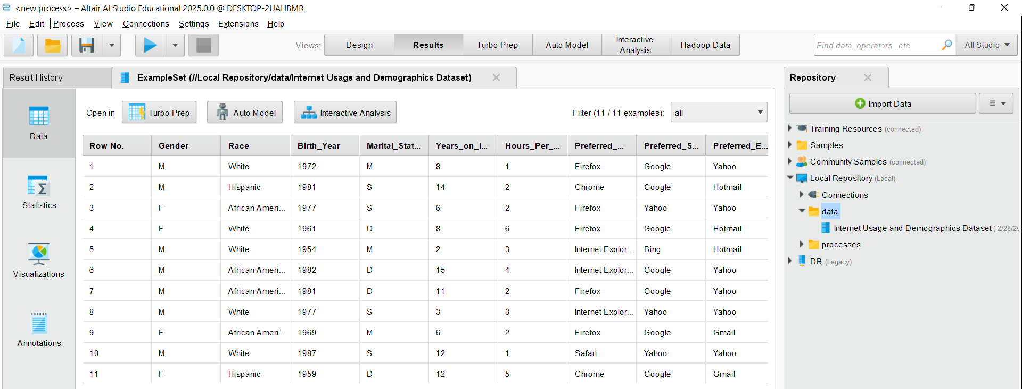
Data Preparation Using RapidMiner
Step 2: Set Up a New Process
2. Add the Dataset
In the Repository panel (usually on the left side), find your dataset (Lab1_Exercise if you renamed it) (I renamed it as Internet Usage and Demographics Dataset).
Double Click on it or Drag and drop the dataset into the Process window.

Slide 10
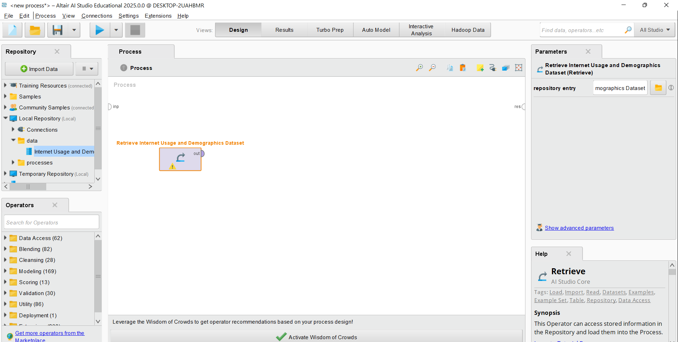
Step 2: Set Up a New Process
2. Add the Dataset
Click on Design, then in the Repository panel, usually on the left side, find your dataset (Lab1_Exercise if you renamed it as a standard name) (I renamed it as “Internet Usage and Demographics Dataset”).
Double Click on it or Drag and drop the dataset into the Process window.

Slide 11
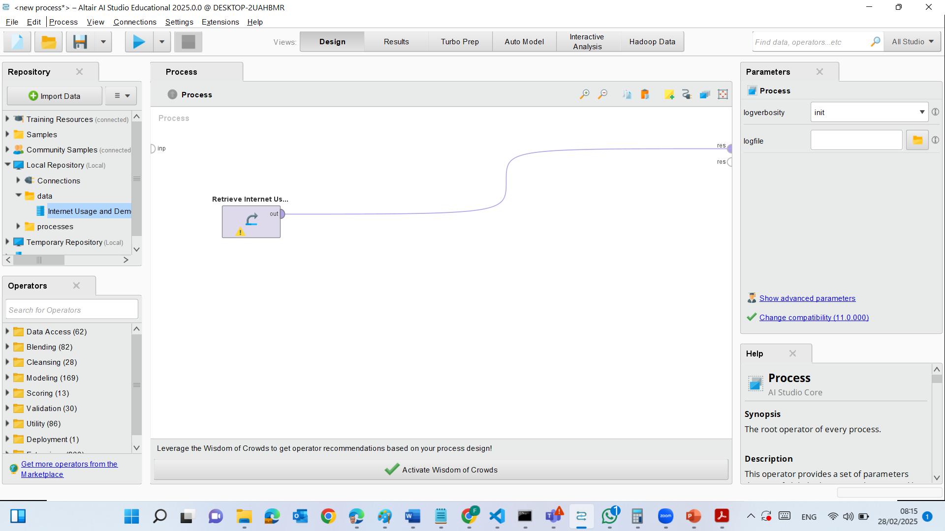
Step 2: Set Up a New Process
3. Connect Operators
When you drag the dataset, it automatically creates a Retrieve Operator.
Locate the Result port (res) at the right side of the Retrieve operator.
Drag a connection (spline) from the Retrieve operator’s output to the res (result) output.

Slide 12
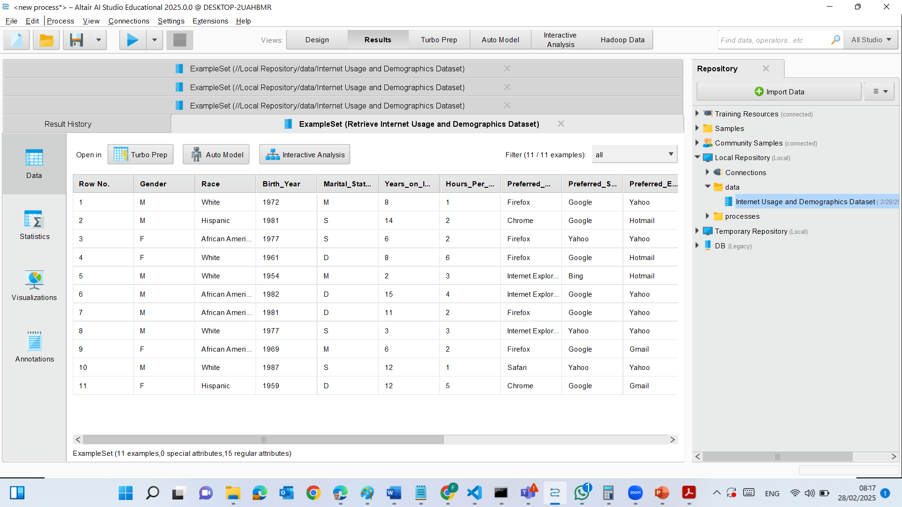
Step 2: Set Up a New Process
4. Run the Process
Click Run (blue play button at the top).
After running, check:
Results View: This shows column names, data types, and attribute statistics.
Data View: Displays actual records in a table format.

Slide 13
Step 2: Set Up a New Process
5. Identify Issues
Look for:
Missing values (empty cells or "?" symbols).
Inconsistent data types (e.g., numbers stored as text).
Unexpected values (e.g., incorrect dates, duplicate entries, or 99 in Twitter column).

Slide 14
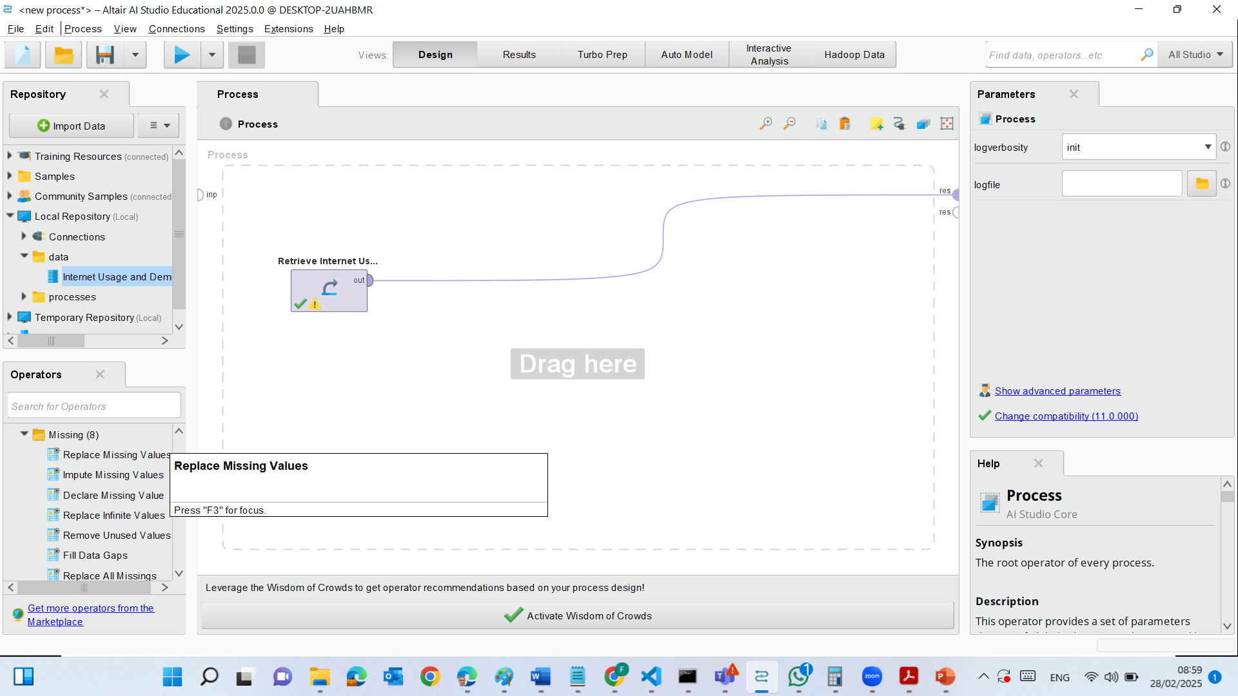
Step 3: Replace Missing Values in RapidMiner
In the Design View >> Find the "Replace Missing Values" operator in the Cleansing section under Operators.
Drag and drop the operator into your process window.
Connect the dataset's output (out) to the Replace Missing Values operator’s input port (exa).

Slide 15
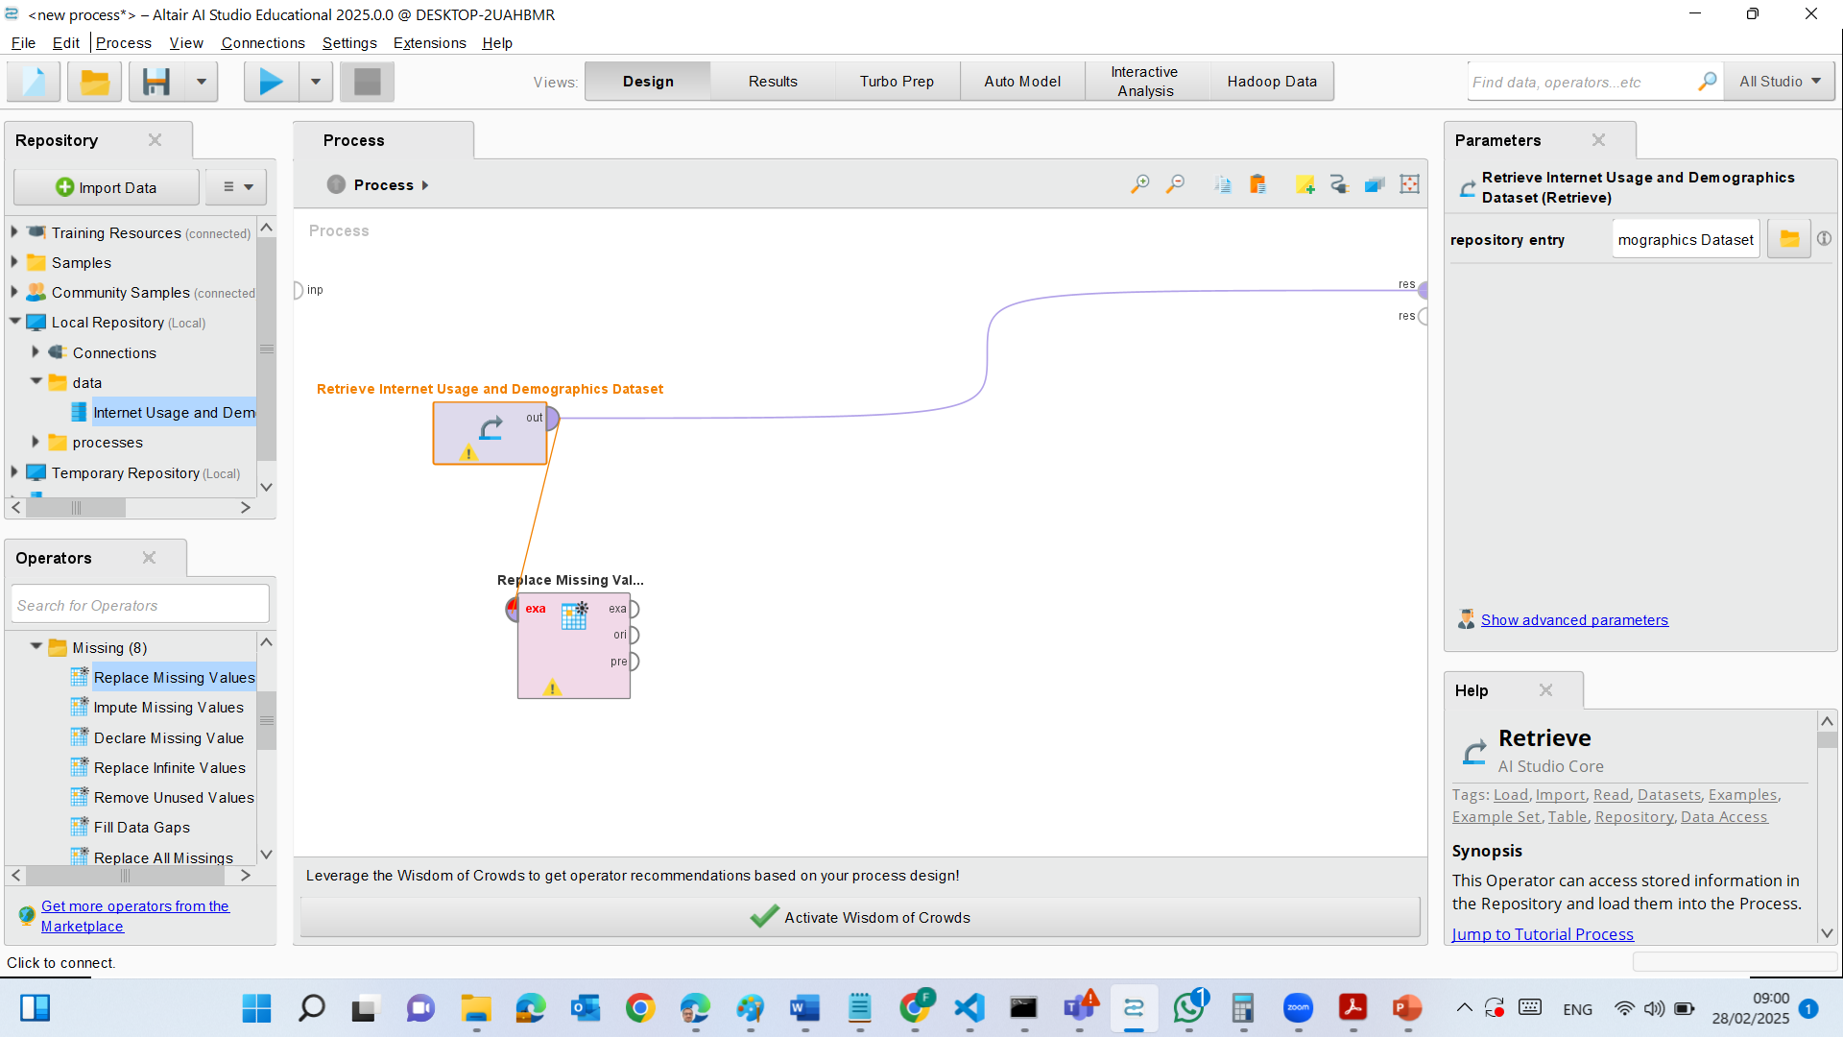
Step 3: Replace Missing Values in RapidMiner
In the Design View >> Find the "Replace Missing Values" operator in the Cleansing section under Operators.
Drag and drop the operator into your process window.
Connect the dataset's output (out) to the Replace Missing Values operator’s input port (exa).

Slide 16
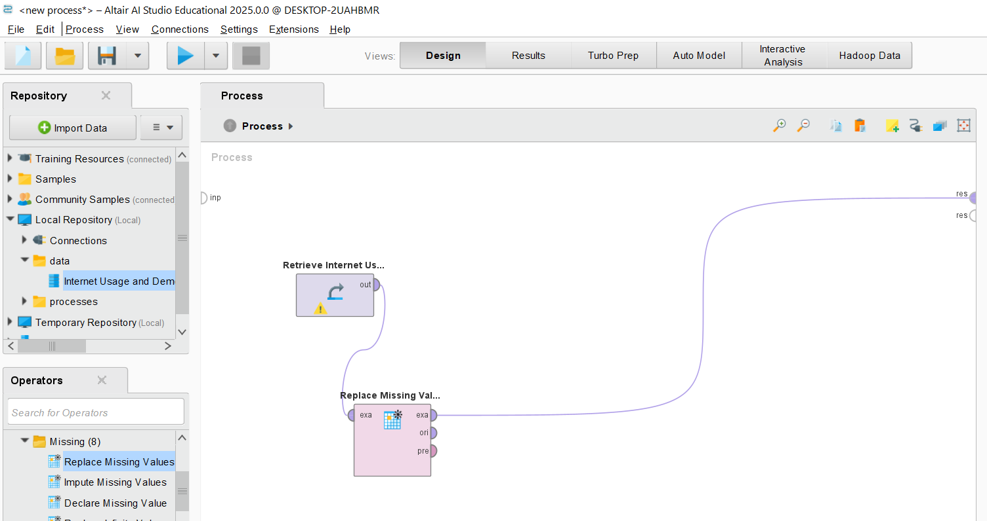
Step 3: Replace Missing Values in RapidMiner
Then, connect the Replace Missing Values "exa" output → to the Result (res) port.

Slide 17
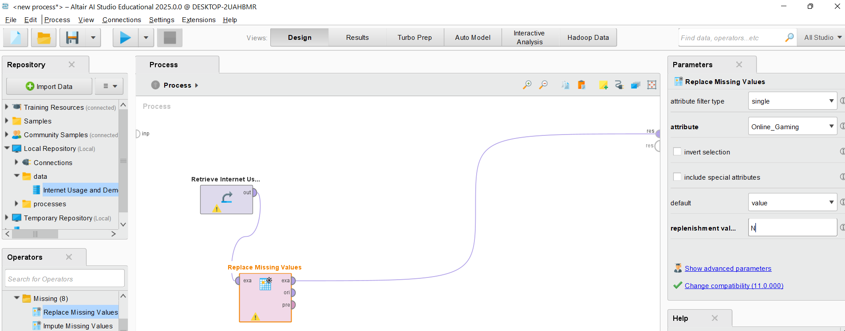
Step 3: Replace Missing Values in RapidMiner
Configure the Replacement Rule
Click on the Replace Missing Values operator to open its settings in the Parameters panel.
Set the following:
Attribute Filter Type: Single
Attribute: Online_Gaming
Default Replacement Value: N (Enter this manually)

Slide 18

Step 3: Replace Missing Values in RapidMiner
Verify the Setup
Check your process connections:
Retrieve → Replace Missing Values → Result (res)
Double-check that the Online_Gaming attribute is selected for replacement.

Slide 19
Step 4: Run and Check Results
Click the Run (▶️) button.
Once executed, go to the Results tab and check:
The Online_Gaming column should no longer have missing values (? symbols should be replaced with "N").

Slide 20
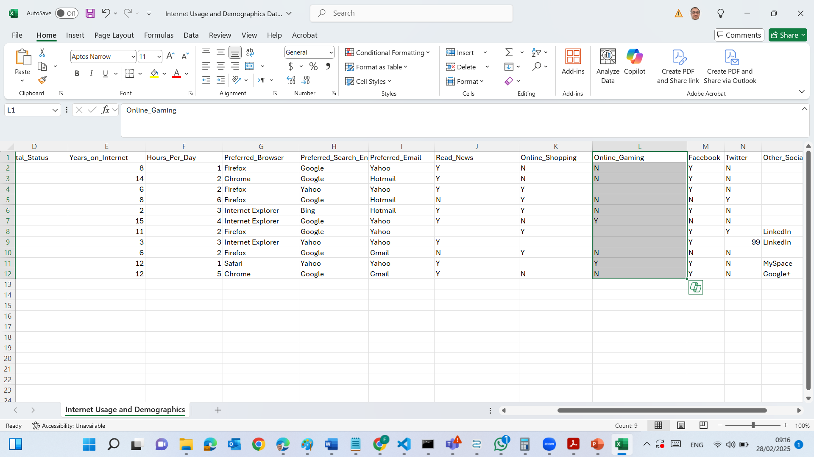
There was missing values in Online Gaming attribute. However, in the new results there is no missing value in this attribute.

Slide 21
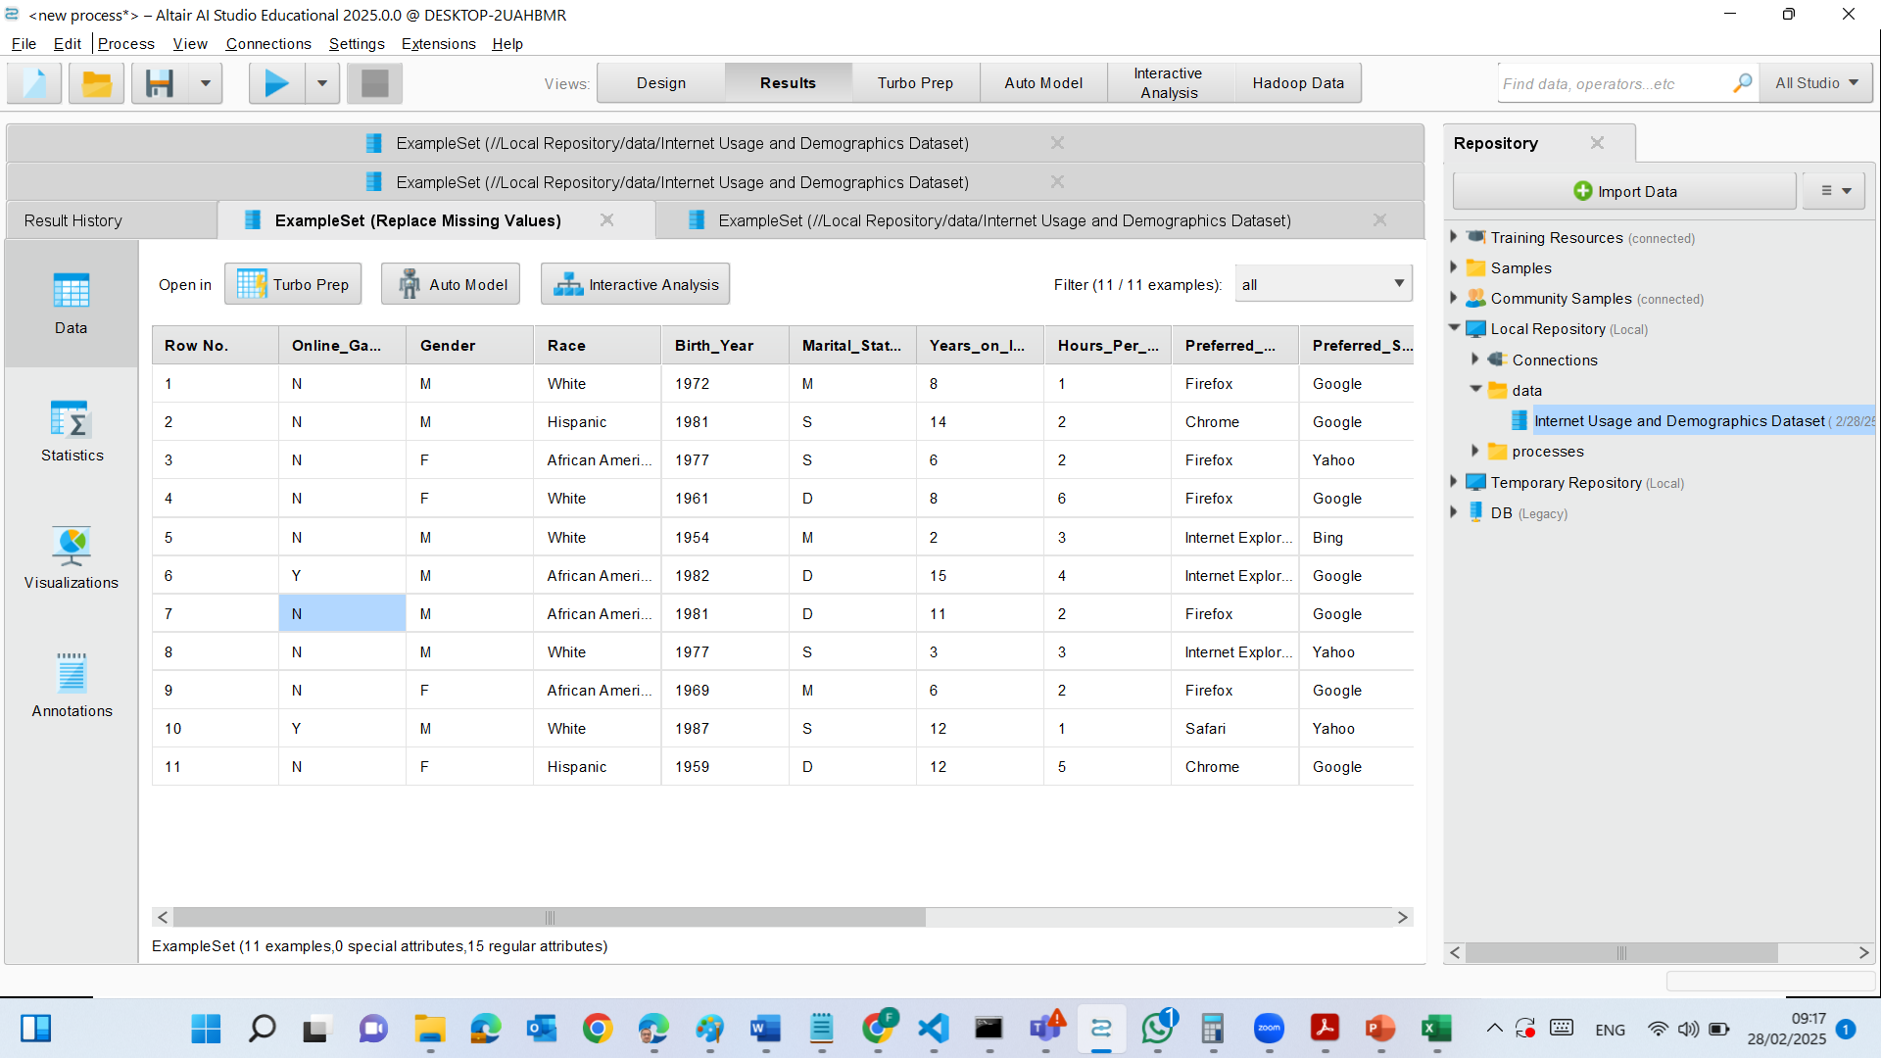
Replacing Missing Values for Online_Gaming:
The Replace Missing Values operator was applied to Online_Gaming.
Any missing value (?) in Online_Gaming was replaced with "N".
This ensures consistency in the dataset.

Slide 22
Online_Gaming column no longer has missing values.
Other columns still contain missing (?) and inconsistent values.

Slide 23
Step 5) Handling Other Missing Values
We still have missing values (?) in:
Online_Shopping
Other_Social_Network
Read_News

Slide 24
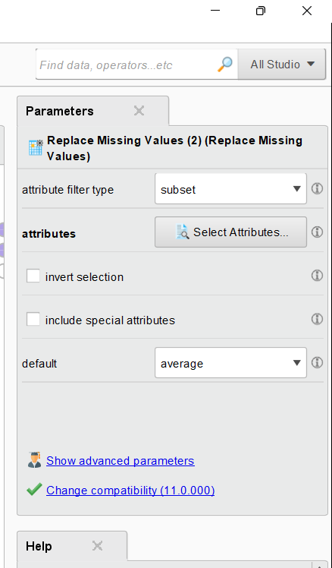
Step 5) Handling Other Missing Values
Configure the Operator:
Select Attribute Filter Type → Subset
Hold Ctrl key and Manually select Online_Gaming, Online_Shopping, Other_Social_Network, and Read_News.
Replace ? with "N".

Slide 25
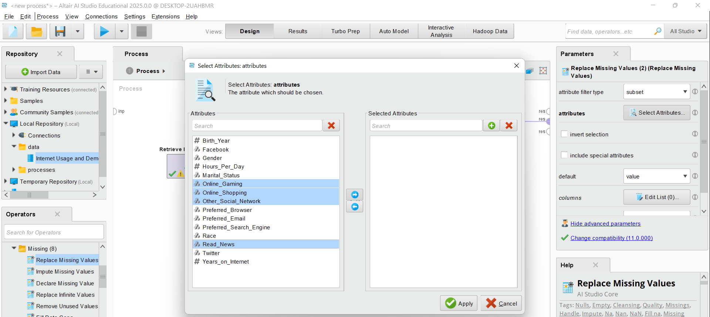
Step 5) Handling Other Missing Values
Configure the Operator:
Select Attribute Filter Type → Subset
Hold Ctrl key and Manually select Online_Gaming, Online_Shopping, Other_Social_Network, and Read_News.
Replace ? with "N".

Slide 26
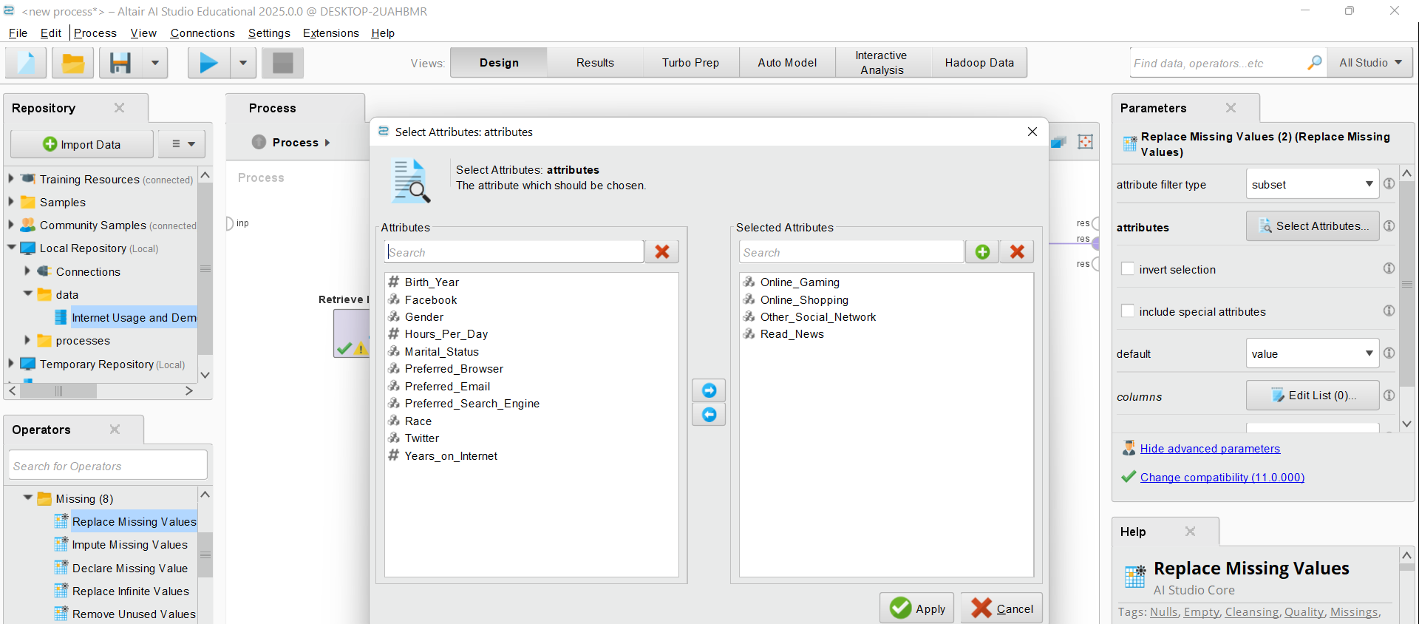
Configure the Operator:
Select Attribute Filter Type → Subset
Hold Ctrl key and Manually select Online_Gaming, Online_Shopping, Other_Social_Network, and Read_News.
Replace ? with "N".

Slide 27
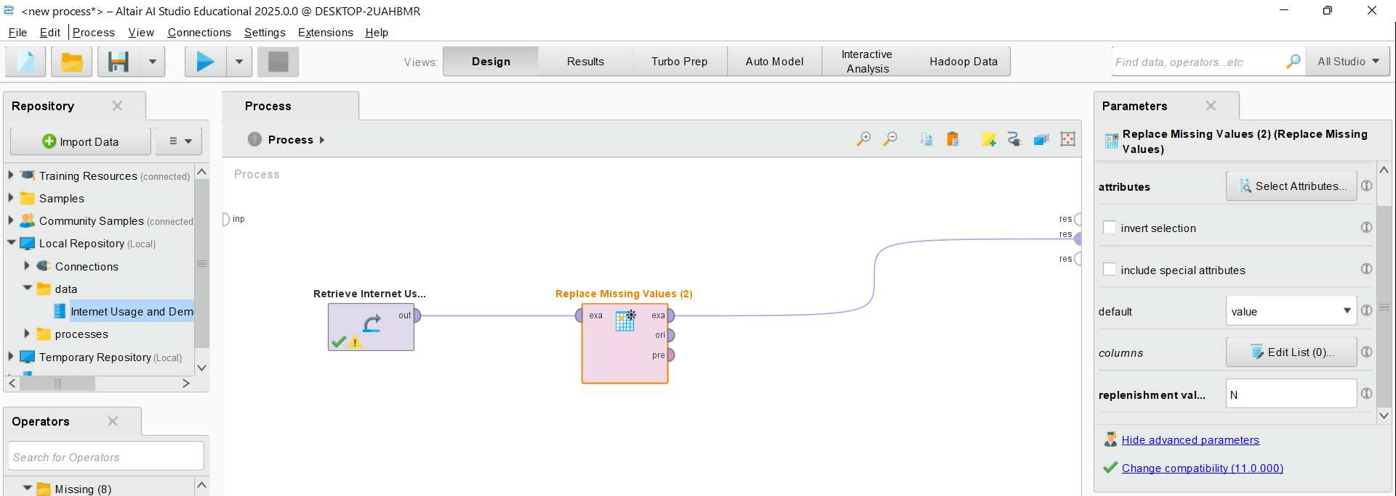
Step 5) Handling Other Missing Values
Configure the Operator:
Select Value for the Default
Type N as for the replenishment value to Replace “?” with "N".

Slide 28
Step 5) Handling Other Missing Values
Run and Check results

Slide 29
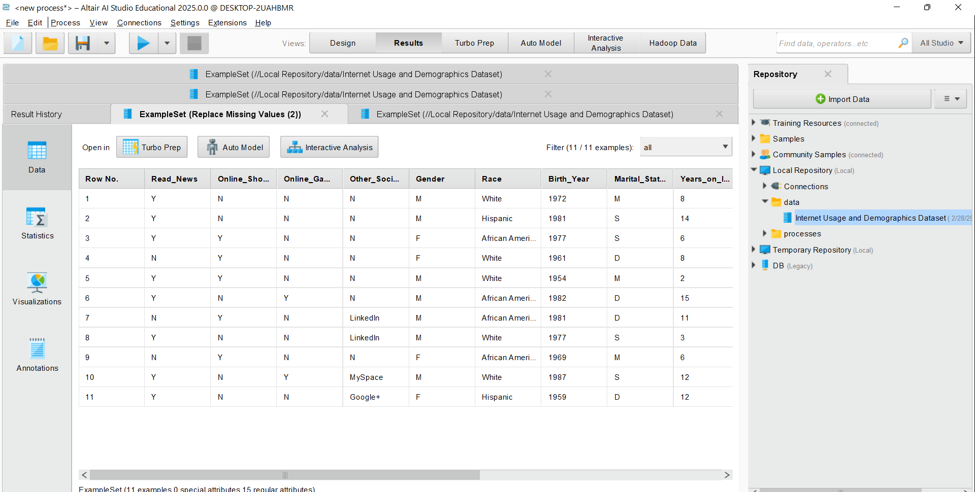
Step 5) Handling Other Missing Values
Run and Check results: There are no missing values!

Slide 30
Key Points to Remember
Missing values can affect analysis, so replacing them ensures cleaner data.
RapidMiner uses the term "ExampleSet" for data rows (observations).
Connecting operators correctly is important for the process to run smoothly.

Slide 31
Your files might also be saved in C:\Users\...\Documents\AltairRapidMiner\AI Studio\Local Repository\data

Slide 32
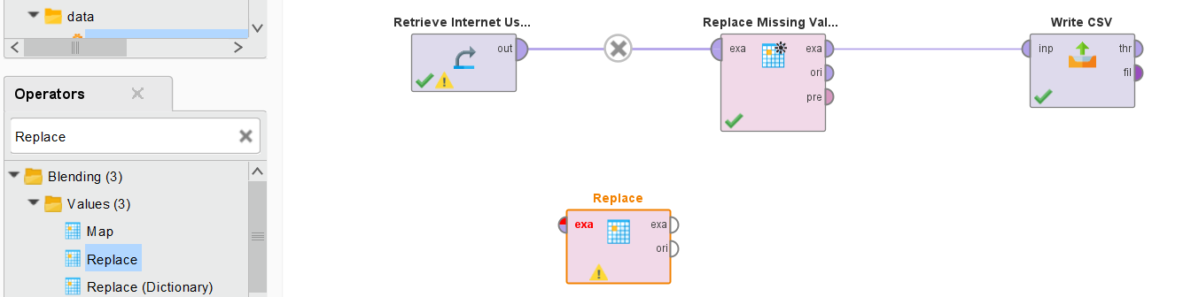
Step 6) Handling Inconsistent Data (e.g., Twitter = 99)
Step 6) Steps to Clean Inconsistent Data in RapidMiner
Locate the "Replace" Operator
In the Operators panel (left side), use the search bar and type Replace.
Expand the Values category under Blending.
Drag and drop the Replace operator into the Process window.

Slide 33
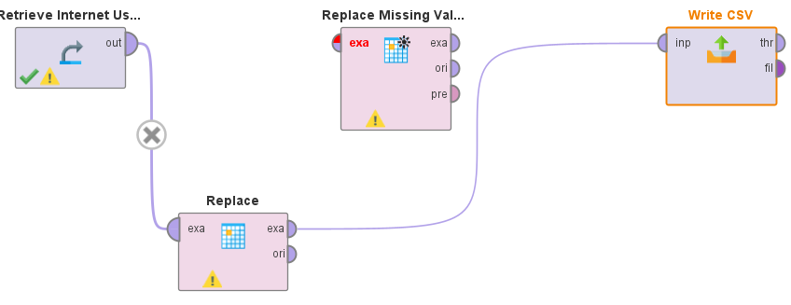
Step 6) Handling Inconsistent Data (e.g., Twitter = 99)
Connect the Replace Operator
Connect the output (out) of the Retrieve Internet Usage operator to the exa (input) of the Replace operator.
Connect the exa (output) of the Replace operator to the next step (e.g., Write CSV or Results).

Slide 34
Configure the Replace Operator
Click on the Replace operator.
In the Parameters panel on the right:
Select Attribute Filter Type: Choose Single.
Choose the Column: Select the column where you want to replace values (e.g., "Twitter").
Find What: Enter 99 (or any inconsistent value that needs replacement).
Replace With: Enter "N" (or another appropriate standardized value).
Enable Regular Expression only if using patterns to find values.

Slide 35
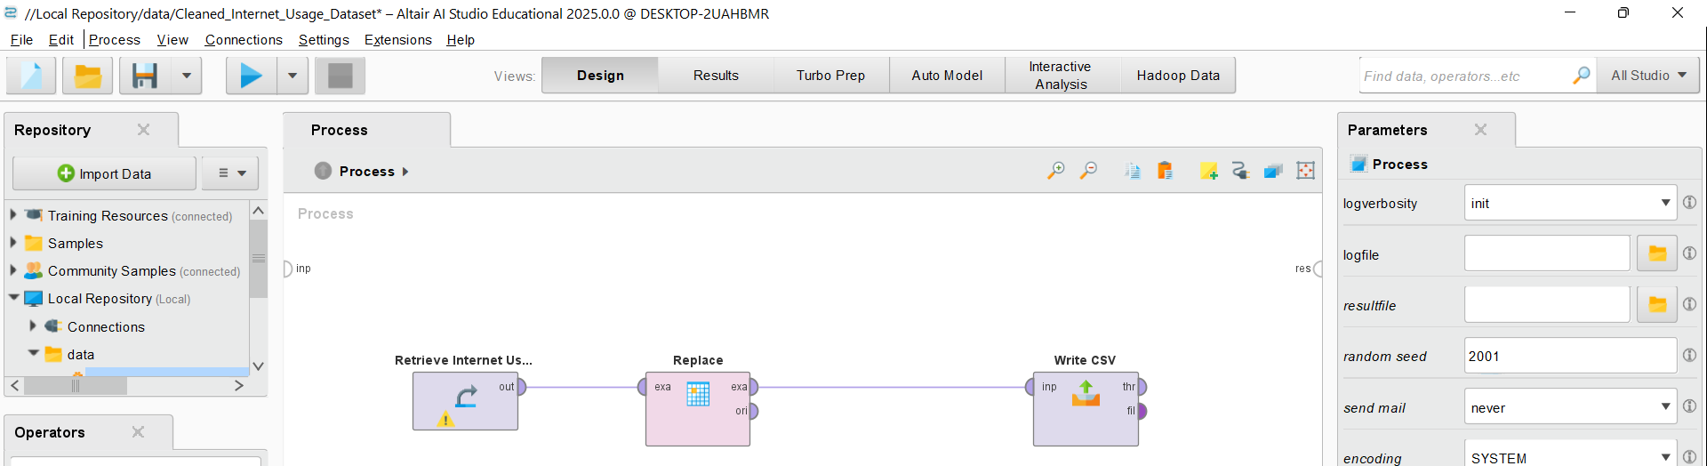
Run the Process
Click the Run (▶️) button at the top.
Once the process completes, go to the Results tab.
Verify that all 99 values in the Twitter column are replaced with "N".

Slide 36
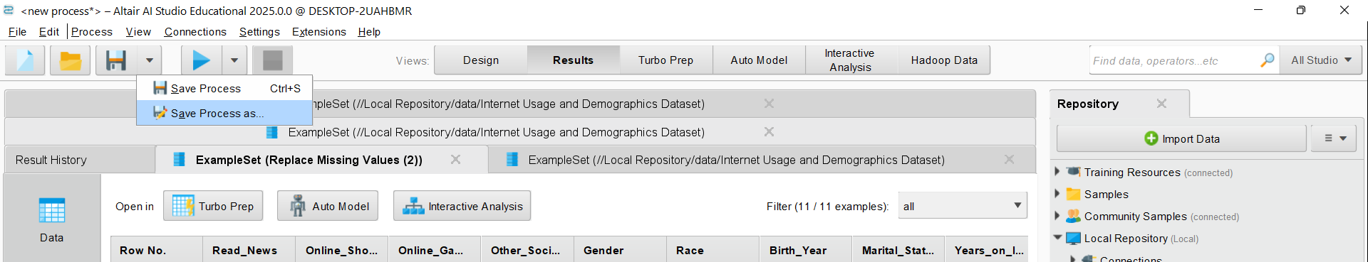
Step 7) Save the Cleaned Dataset in RapidMiner
Go to the "Results" Tab (which you are already in).
Click on the Save Icon (Disk icon at the top of the Results tab).
Click on Save Process As
Choose the Save Location:
In the Repository panel, go to Local Repository → data.
Click "Save As" and enter a new name (e.g., Cleaned_Internet_Usage_Dataset).
Make sure the file format is .csv or another preferred format.

Slide 37
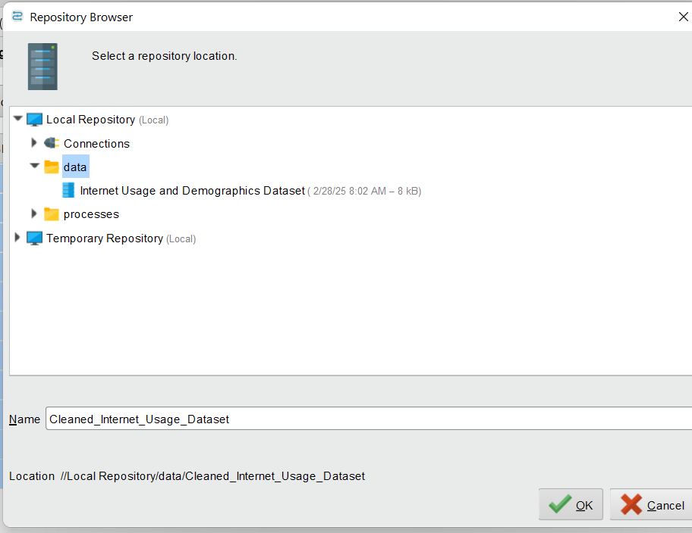
Step 7) Save the Cleaned Dataset in RapidMiner
Go to the "Results" Tab (which you are already in).
Click on the Save Icon (Disk icon at the top of the Results tab).
Click on Save Process As
Choose the Save Location:
In the Repository panel, go to Local Repository → data.
Click "Save As" and enter a new name (e.g., Cleaned_Internet_Usage_Dataset).
Make sure the file format is .csv or another preferred format.

Slide 38
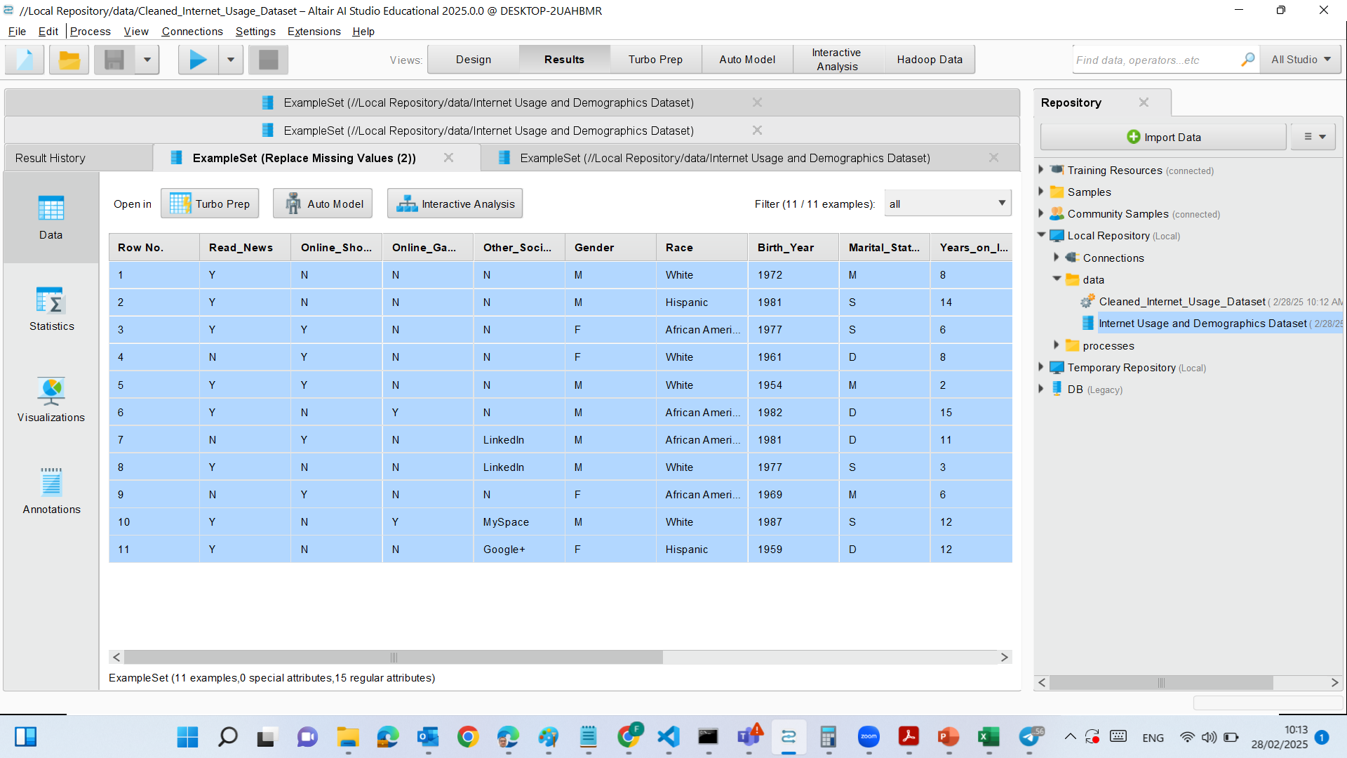
Step 7) Save the Cleaned Dataset in RapidMiner

Slide 39
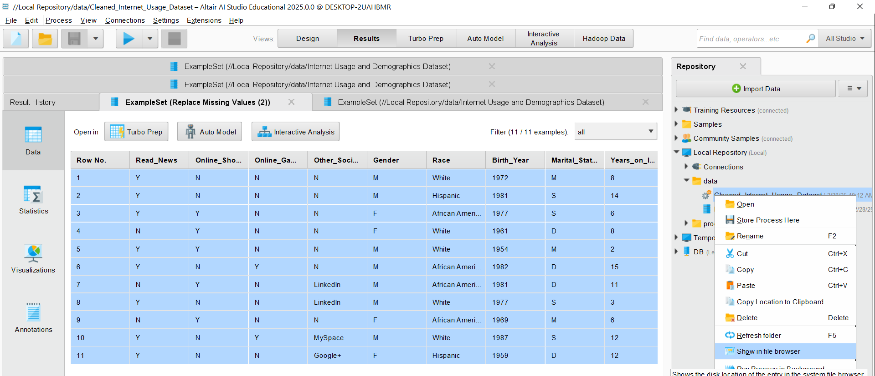
See data in file browser

Slide 40
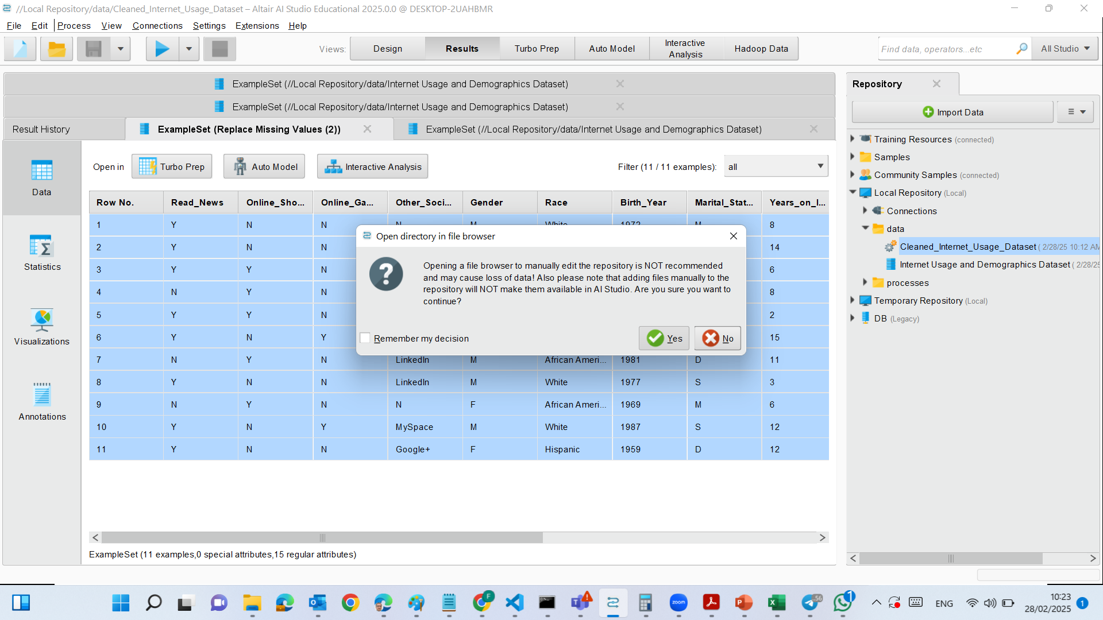
See data in file browser

Slide 41
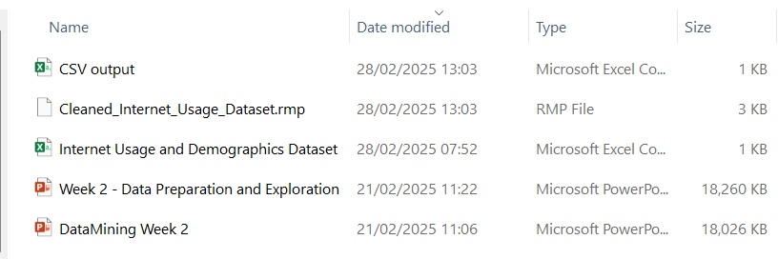
See data in file browser

Slide 42
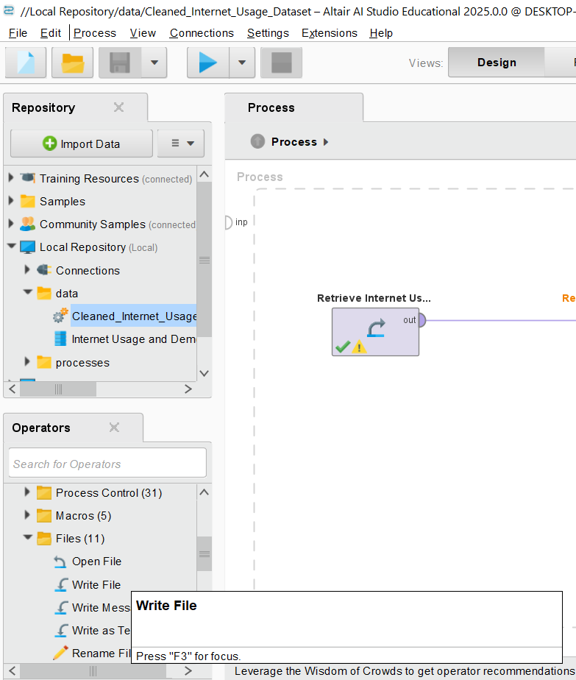
Export as a CSV File
If we want to export the dataset for external use (e.g., Excel, Python, SQL, etc.), we should follow these steps:
Go to "Processes" View (Design mode).
Search for "Write CSV" Operator (under Operators → Data Access → Write CSV).
Drag the "Write CSV" Operator into the process window.

Slide 43
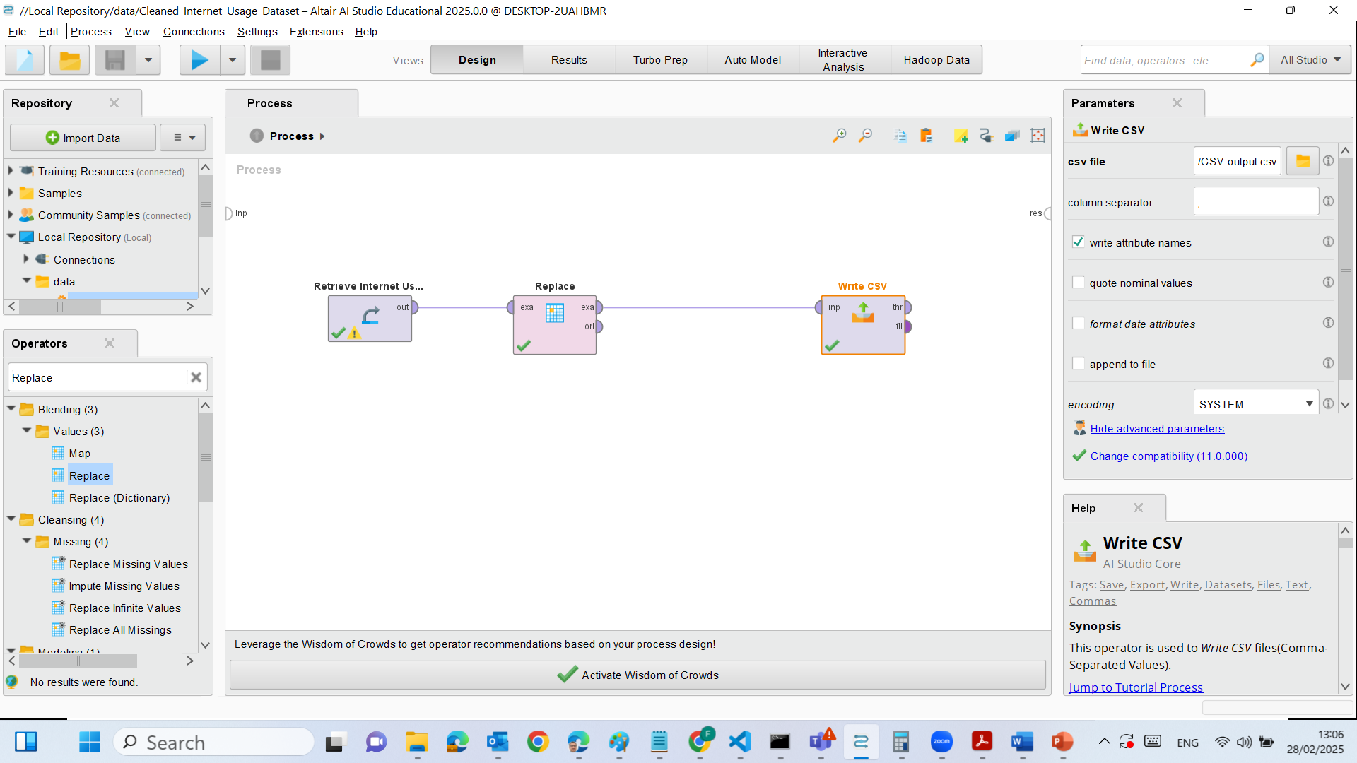
Connect it:
Replace Missing Values output ("exa") → Write CSV input ("inp").

Slide 44
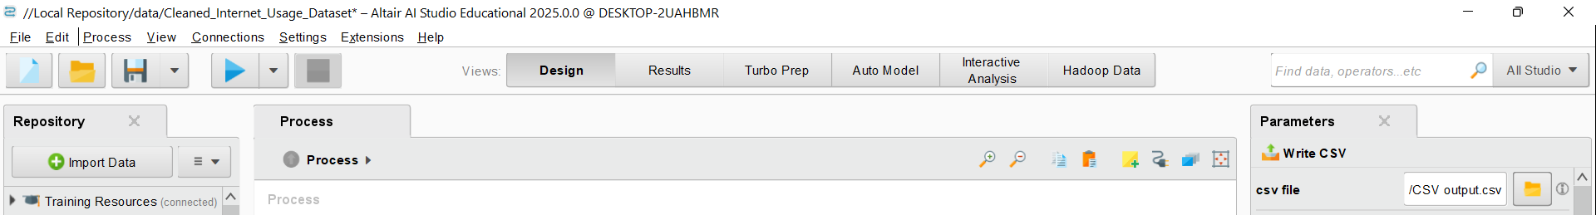
Set Parameters:
In the Parameters panel, choose a location (e.g., C:\Users\YourName\Documents\Cleaned_Internet_Usage.csv).

Slide 45
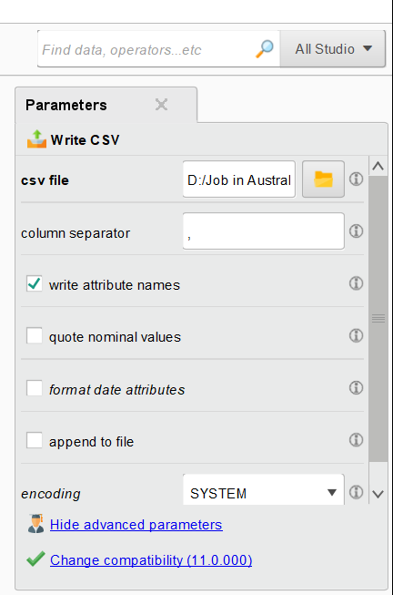
Set Parameters:
Enable Writing Attribute Names:
Ensure "write attribute names" is checked.
Avoid Extra Quotes on Text Fields:
Uncheck "quote nominal values" unless necessary.
Check Formatting of Date Attributes:
Disable "format date attributes" unless you need it.

Slide 46
Run the Process and Check the Saved File
Click on Blue Run button

Slide 47
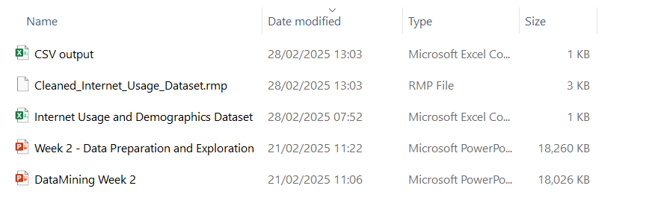
Run the Process and Check the Saved File
Click on Blue Run button

Slide 48
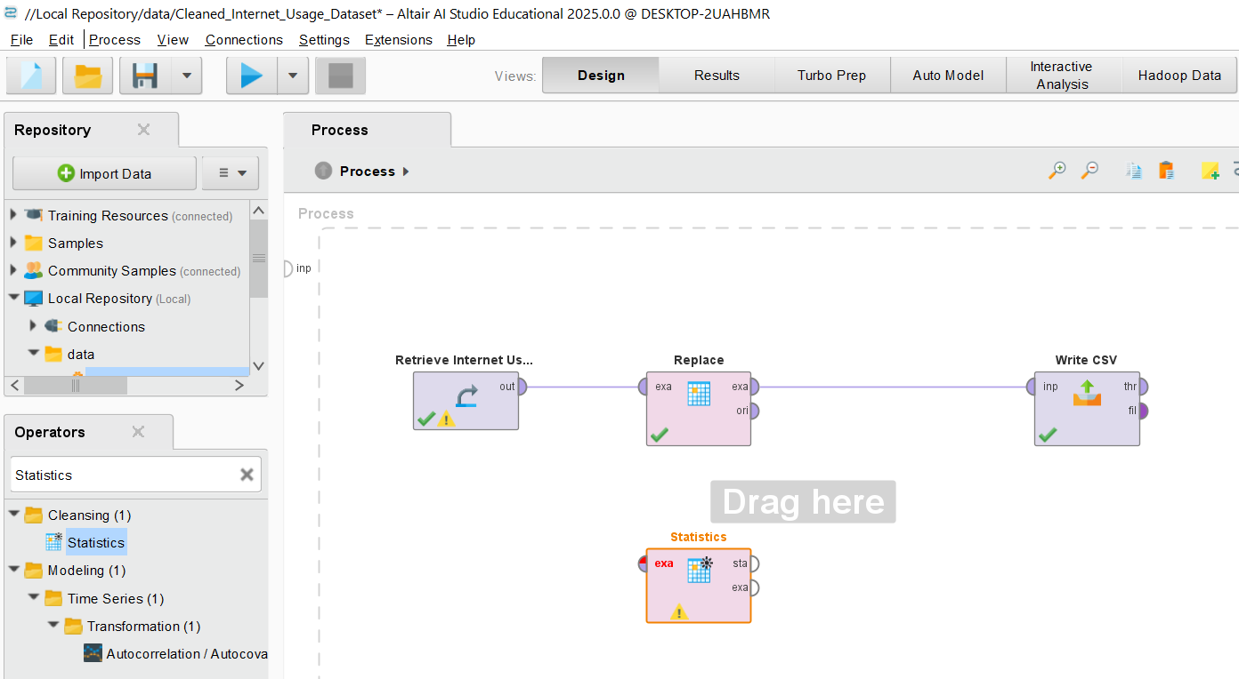
Step 8) Generate Summary Statistics to Verify Data Correctness
Locate the “Statistics” Operator
In the Operators panel (left side), use the search bar and type "Statistics".
Under the Cleansing category, locate the Statistics operator.
Drag and drop the Statistics operator into the Process workspace.

Slide 49
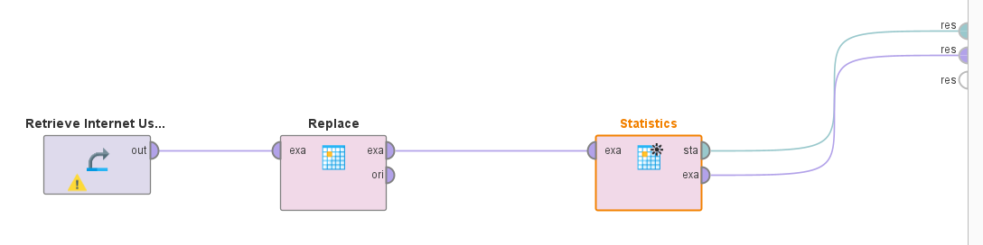
Step 8) Generate Summary Statistics to Verify Data Correctness
Connect the Statistics Operator
Disconnect the Write CSV temporarily.
Connect the output (exa) of the Replace operator to the input (exa) of the Statistics operator.
The output (res) of the Statistics operator should be connected to res (right side)

Slide 50
Step 8) Generate Summary Statistics to Verify Data Correctness
No specific configurations are needed
We need to verify that:
All numerical and categorical attributes are included.
Ensure that the Twitter column (or any replaced values) is included.

Slide 51
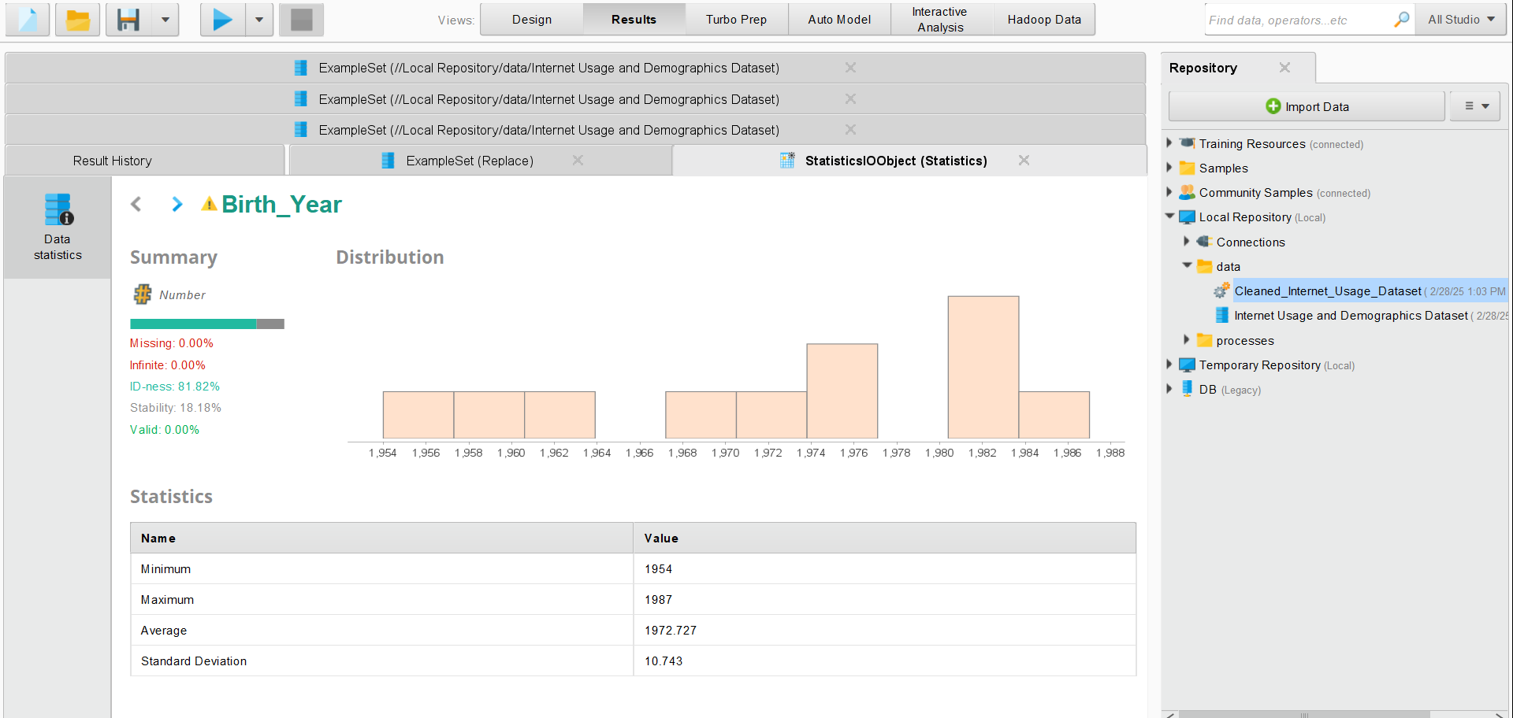
Step 8) Generate Summary Statistics to Verify Data Correctness
Run the Process
Click the Run (▶️) button at the top.
Once completed, go to the Results tab and Select Statistics.
The summary statistics will be displayed, showing:
Mean, Median, Min, Max for numerical columns.
Unique values, Mode for categorical columns.
Count of missing values (if any remain).

Slide 52
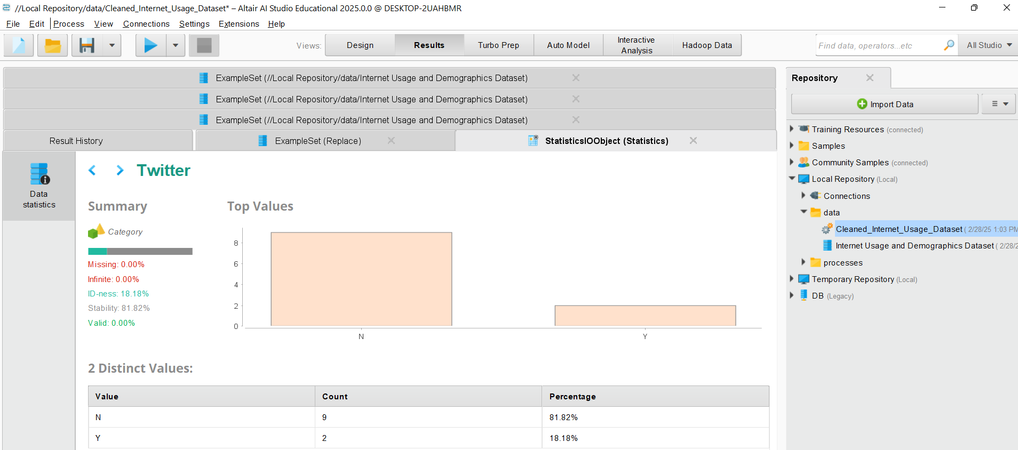
Select ‘Twitter’ to Verify Data Correctness
Check if the 99 values in the Twitter column were successfully replaced with "N".
Ensure no unexpected missing values are present.
Verify if the data distributions match expectations.

Slide 53

Analysis of ‘Birth_Year’
The minimum birth year is 1954, and the maximum is 1987.
The mean birth year is ~1972, meaning the dataset likely contains middle-aged individuals.
The standard deviation is 10.743, indicating a reasonable spread of ages.

Slide 54
Histogram (Distribution of Birth Years):
The histogram shows grouped bins of birth years.
There is a peak between 1975 and 1982, meaning most individuals in this dataset were born in that range.
Fewer individuals were born before 1960 or after 1985, suggesting an older demographic.

Slide 55
Most individuals fall in the 1975–1982 range.
No missing or infinite values, making this a clean dataset for analysis.
High uniqueness (ID-ness), meaning this column is not ideal for categorical grouping.
The dataset likely represents a middle-aged population.

Slide 56
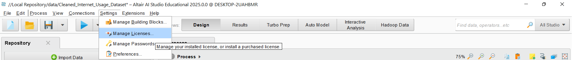
Manage Licenses

Slide 57
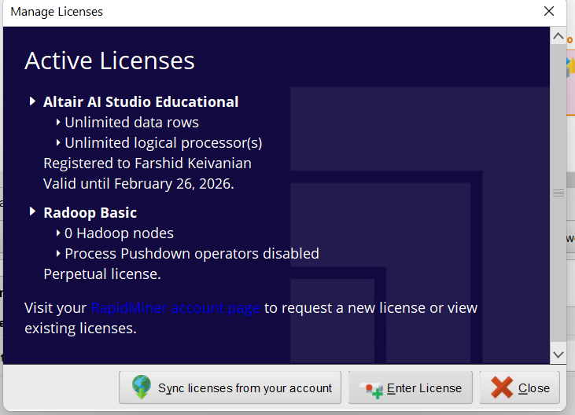
Enter License

Slide 58
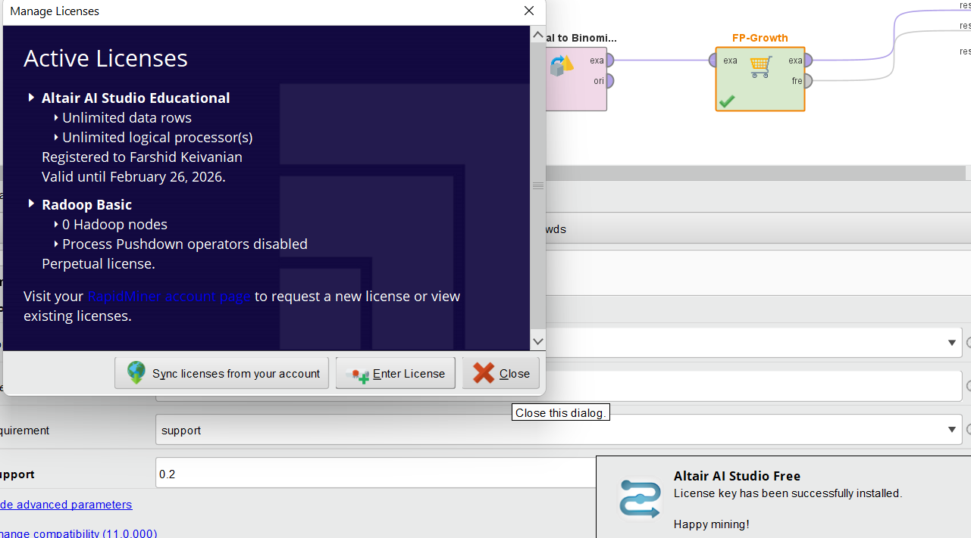
Enter License
License Key has been successful installed.
Happy mining!

Slide 59
Submission of Labs & Assessments
These guidelines are designed to support your learning and help you apply necessary techniques effectively. For lab or assessment submissions, please follow instructions and complete tasks based on Canvas. If you have any questions, feel free to ask—I’m happy to help!

Slide 60
Thank You
Have a Great Learning Day!
Feel free to reach out with any questions!
Dr. Farshid Keivanian

